Slide 1
RFID BASED ATTENDANCE SYSTEM
PROJECT BY MOKSHDA BHATT
ROLL NO- 23117061

Slide 2
PURPOSE OF THIS PROJECT
The inspiration behind this project is to automate the manual process of marking attendance prevalent in schools, colleges, hostels.
Students/working professionals can mark their attendance using their id cards which would use RFID technology.
This project would save time and will empower we students to work more with technology.

Slide 3
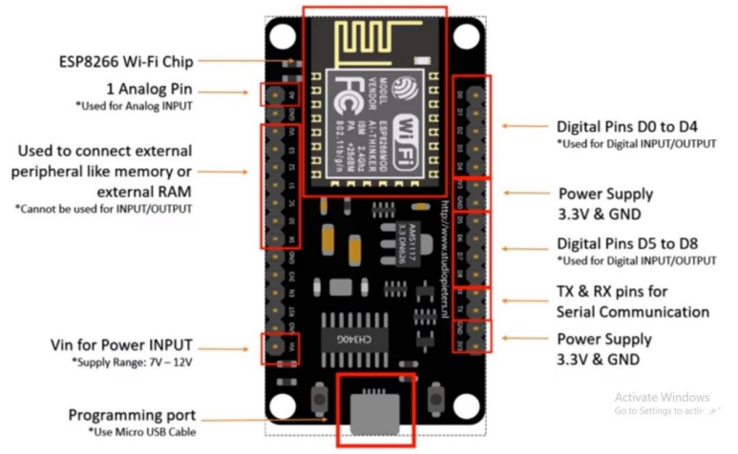
COMPONENTS USED IN THIS PROJECT
1. NODEMCU ESP 8266
NodeMCU is open source low cost IOT platform. Since NodeMCU is open open source platform their hardware design is open for edit ,modify and build. It includes firmware which runs on the ESP8266 Wi-Fi SoC from Espressif Systems, and hardware which is based on the ESP-12 module. The firmware uses the Lua scripting language. • Integrated WiFi: Ideal for projects requiring wireless connectivity. • Cost-Effective: NodeMCU boards are generally affordable. • Rapid Prototyping: Quick development and prototyping with Lua scripting.

Slide 4
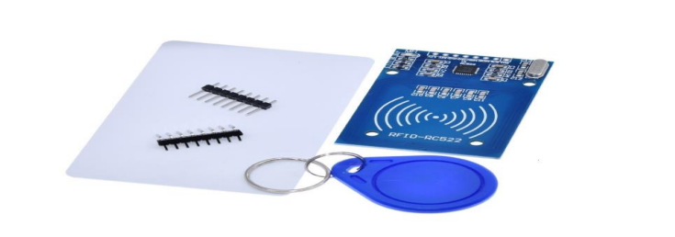
COMPONENTS USED IN THIS PROJECT
2. RFID MFRC 522 AND TAGS
An RFID or radio frequency identification system consists of two main components, a tag attached to the object to be identified, and a reader that reads the tag. A reader consists of a radio frequency module and an antenna that generates a high frequency electromagnetic field. Whereas the tag is usually a passive device (it does not have a battery). It consists of a microchip that stores and processes information, and an antenna for receiving and transmitting a signal. The chip then responds by sending its stored information back to the reader in the form of another radio signal. This is called a backscatter. The reader detects and interprets this backscatter and sends the data to a computer or microcontroller.

Slide 5
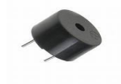
COMPONENTS USED IN THIS PROJECT
3. BUZZER
An audio signaling device like a buzzer may be electromechanical or piezoelectric or mechanical type. The main function of this is to convert the signal from audio to sound. Generally, it is powered through DC voltage and used in timers etc

Slide 6
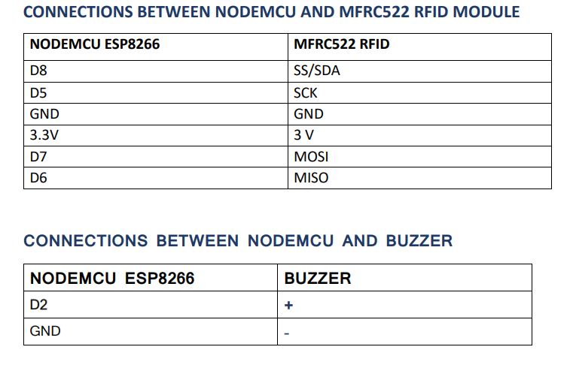
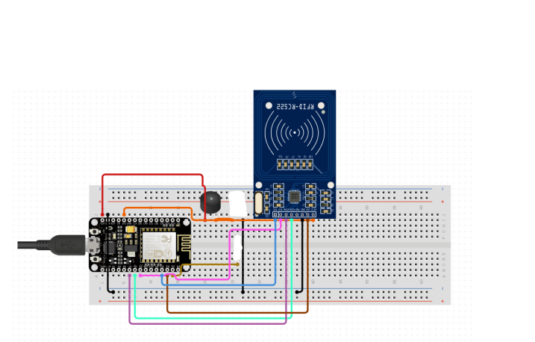
SCHEMATIC DIAGRAM OF CIRCUIT CONNECTION

Slide 7
THANK YOU

